Slide 1

Your past, your present and your future

Slide 2


Slide 3


Slide 4
Overview
Idea
Technologies
Competitors
Costs
Team
Planification
Demo
Piloting plan

Slide 5
IDEA
What is Capsulefy?

Slide 6





Time capsule

Slide 7


Payment plans
 | Free | Premium
Price | 0 € | 11.99 €
Storage | 20 MB/user | 500 MB/capsule
Social network and email integration
Capsule scheduling | 1 year | No limit
Capsule expiration | 6 months after release | No expiration
Modular and private capsules

Slide 8
TECHNOLOGIES
What stack do we use?

Slide 9





Web app
Users and capsules
Media storage
Social networks

Slide 10


Testing
Functional and integration
Performance
Coverage

Slide 11





Slide 12
COMPETITORS
What makes us different?

Slide 13
 | Viajeros en el tiempo | Mytimecapsule | Miigen | thetimecapsule | Capsulefy
Automatic content publication
Free plan
Premium plan
Images
Videos
Social network integration
Deadman switch

Slide 14
COSTS
How much does Capsulefy cost?

Slide 15
Project duration | 4 months
Salaries | 20.80 €/hour
Hours per month | 40
Amortization | 60 months
Equipment | 306 €
Hosting (1 year) | 669 €
Advertising (6 months) | 3060 €
Risk prevention | 10% (2724 €)
Total | 29968 €

Slide 16
TEAM
Who is behind?

Slide 17
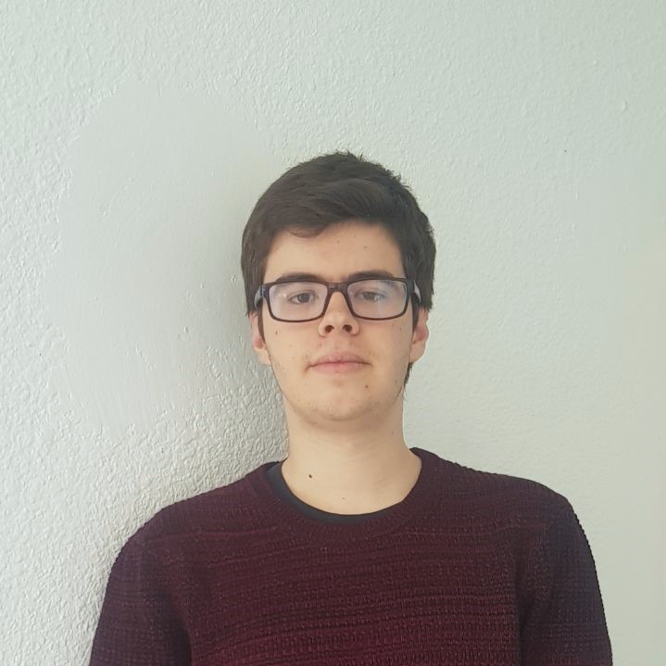
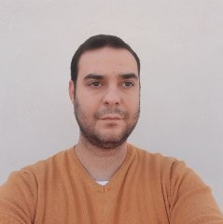




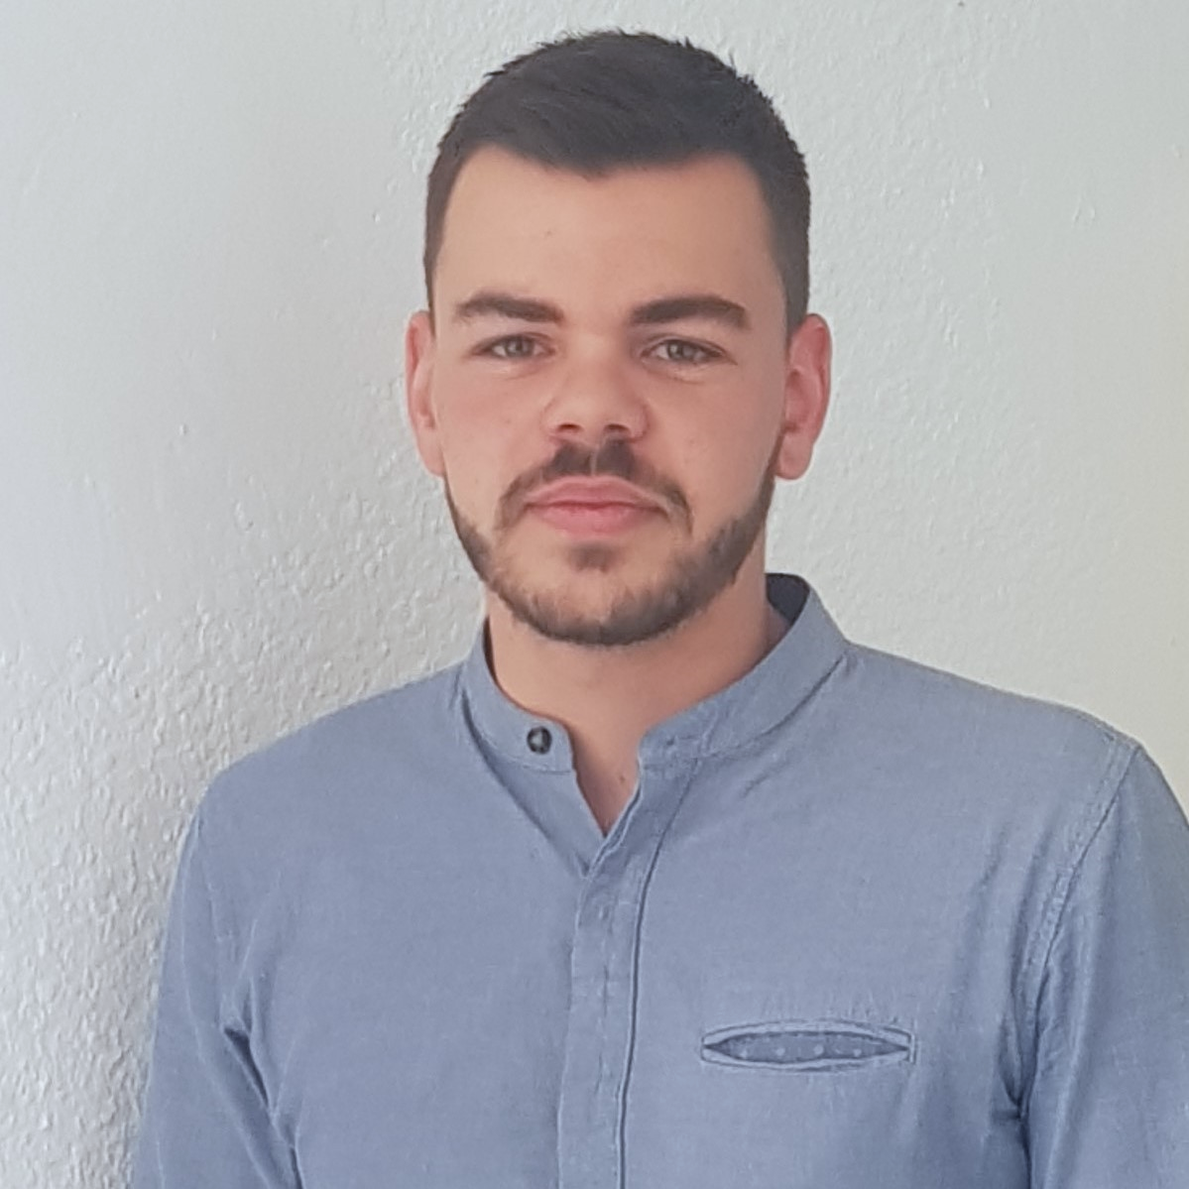
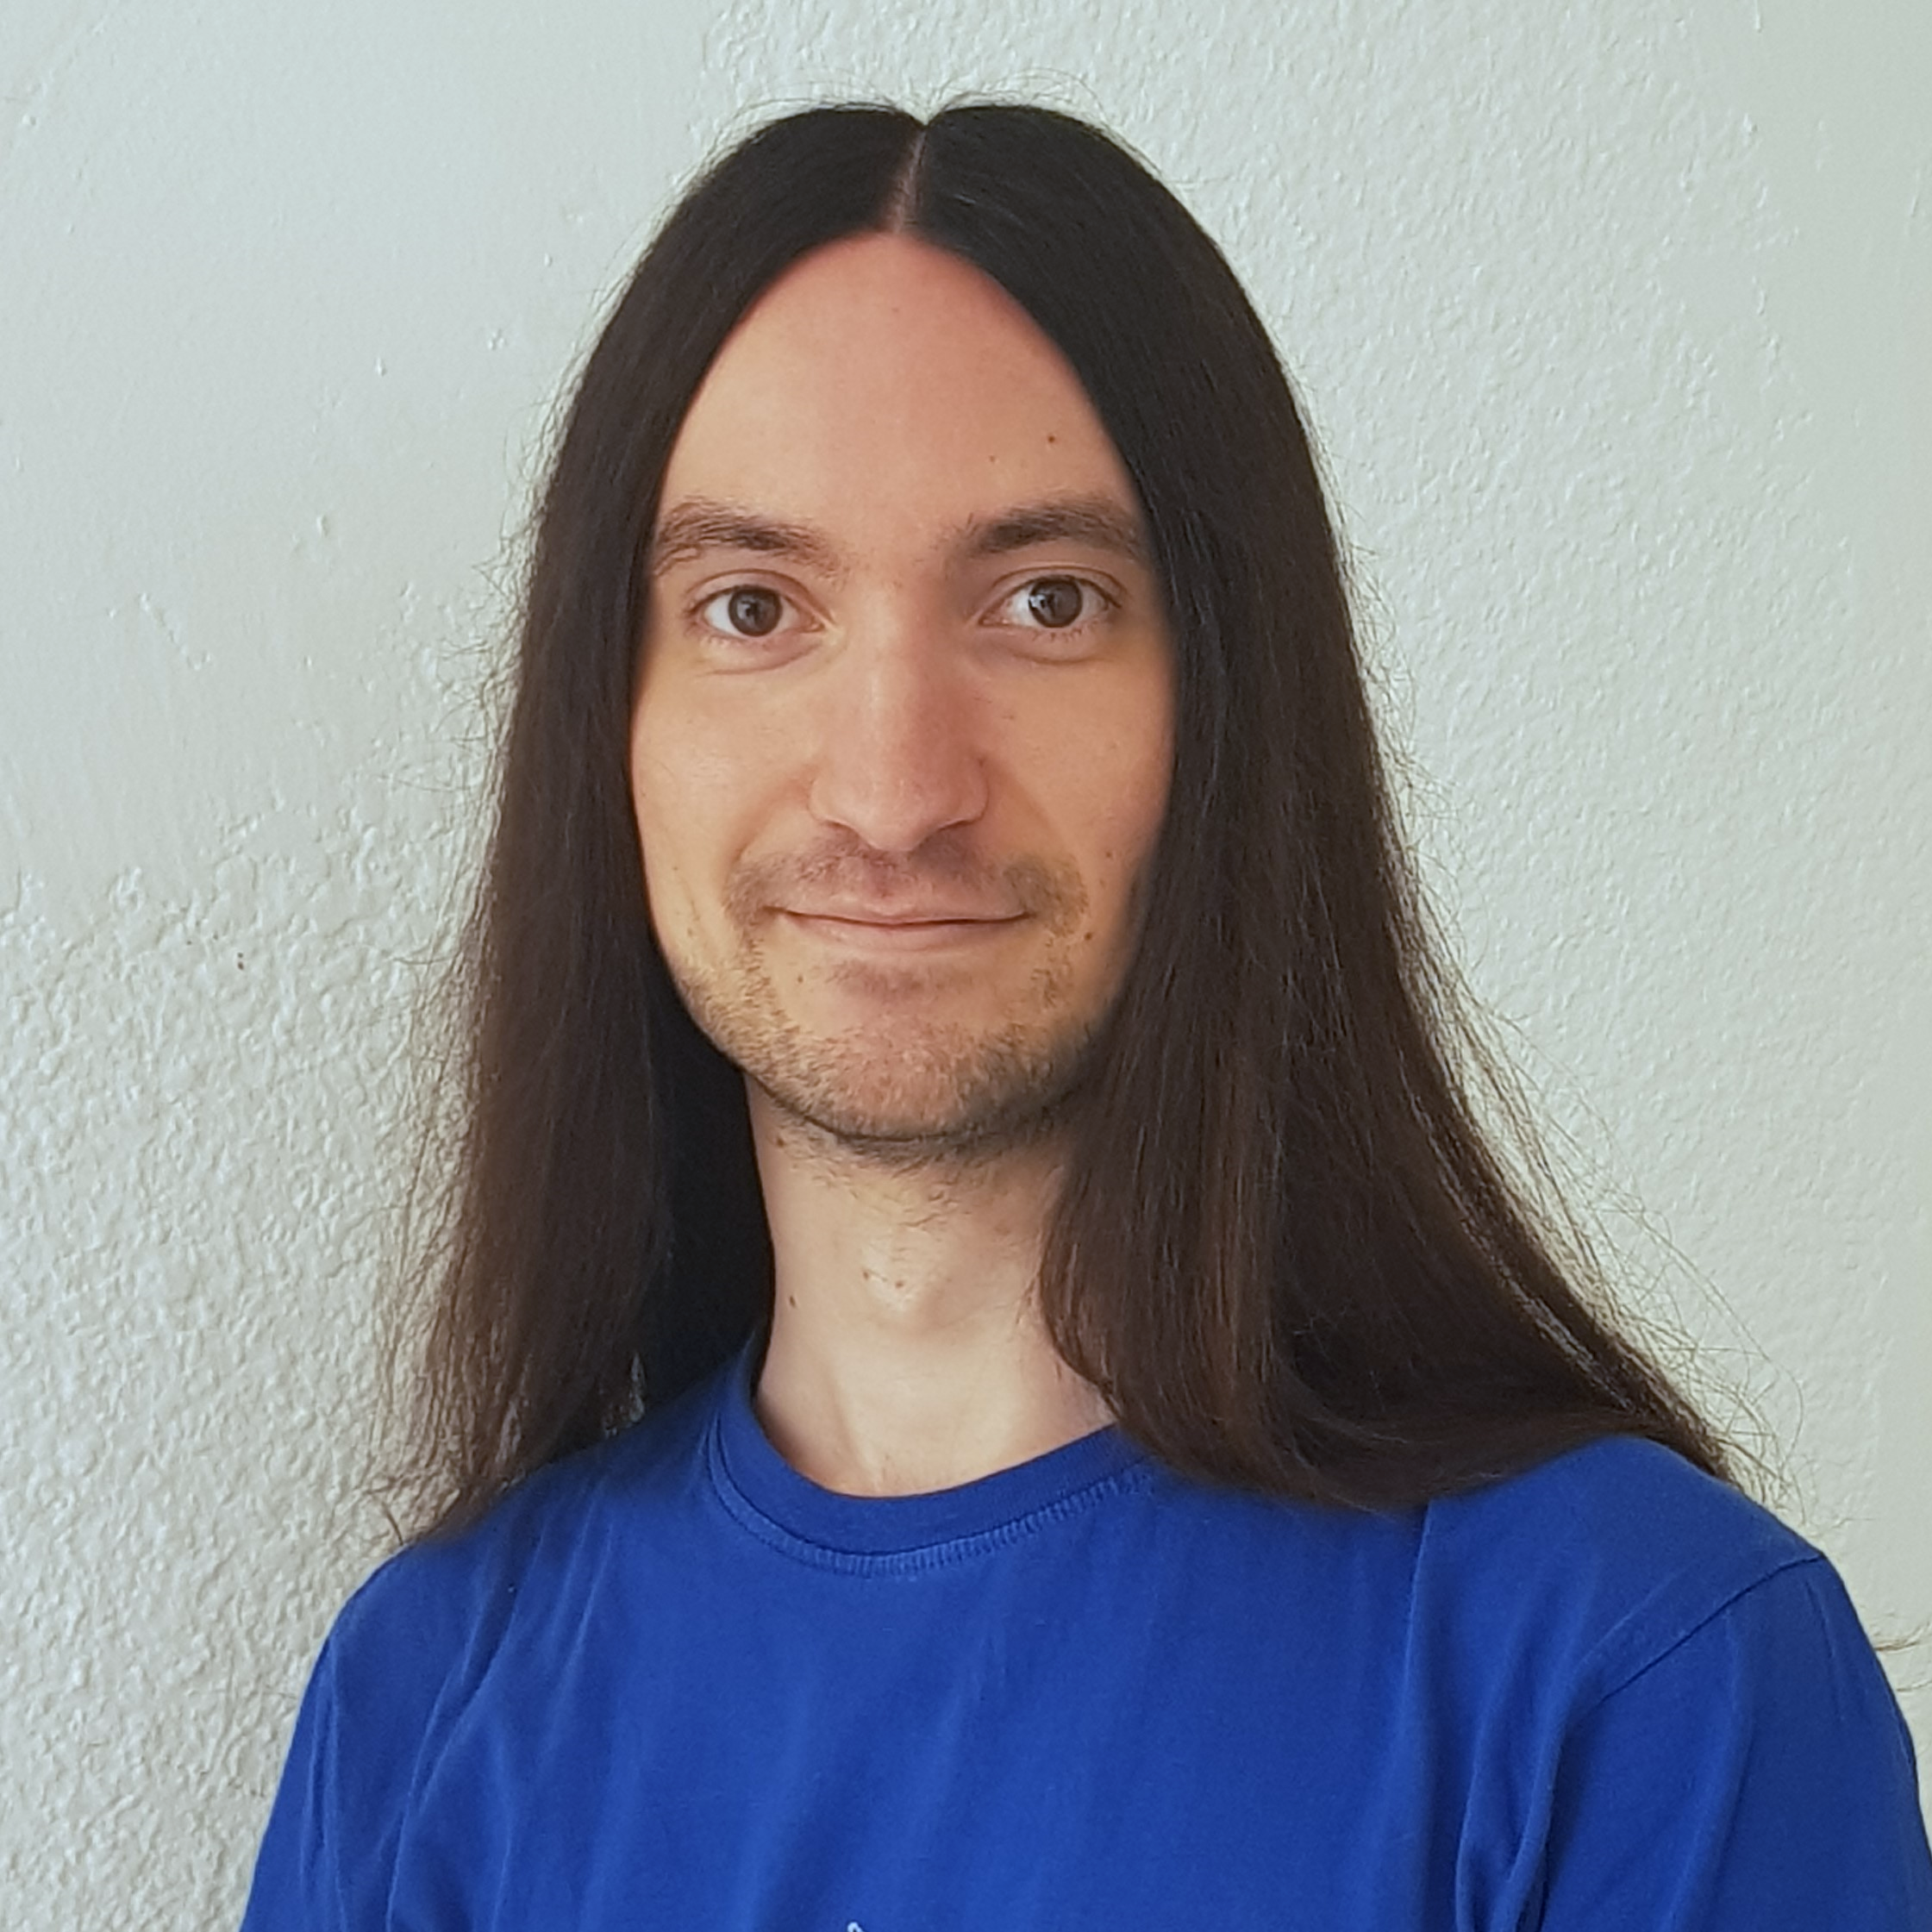


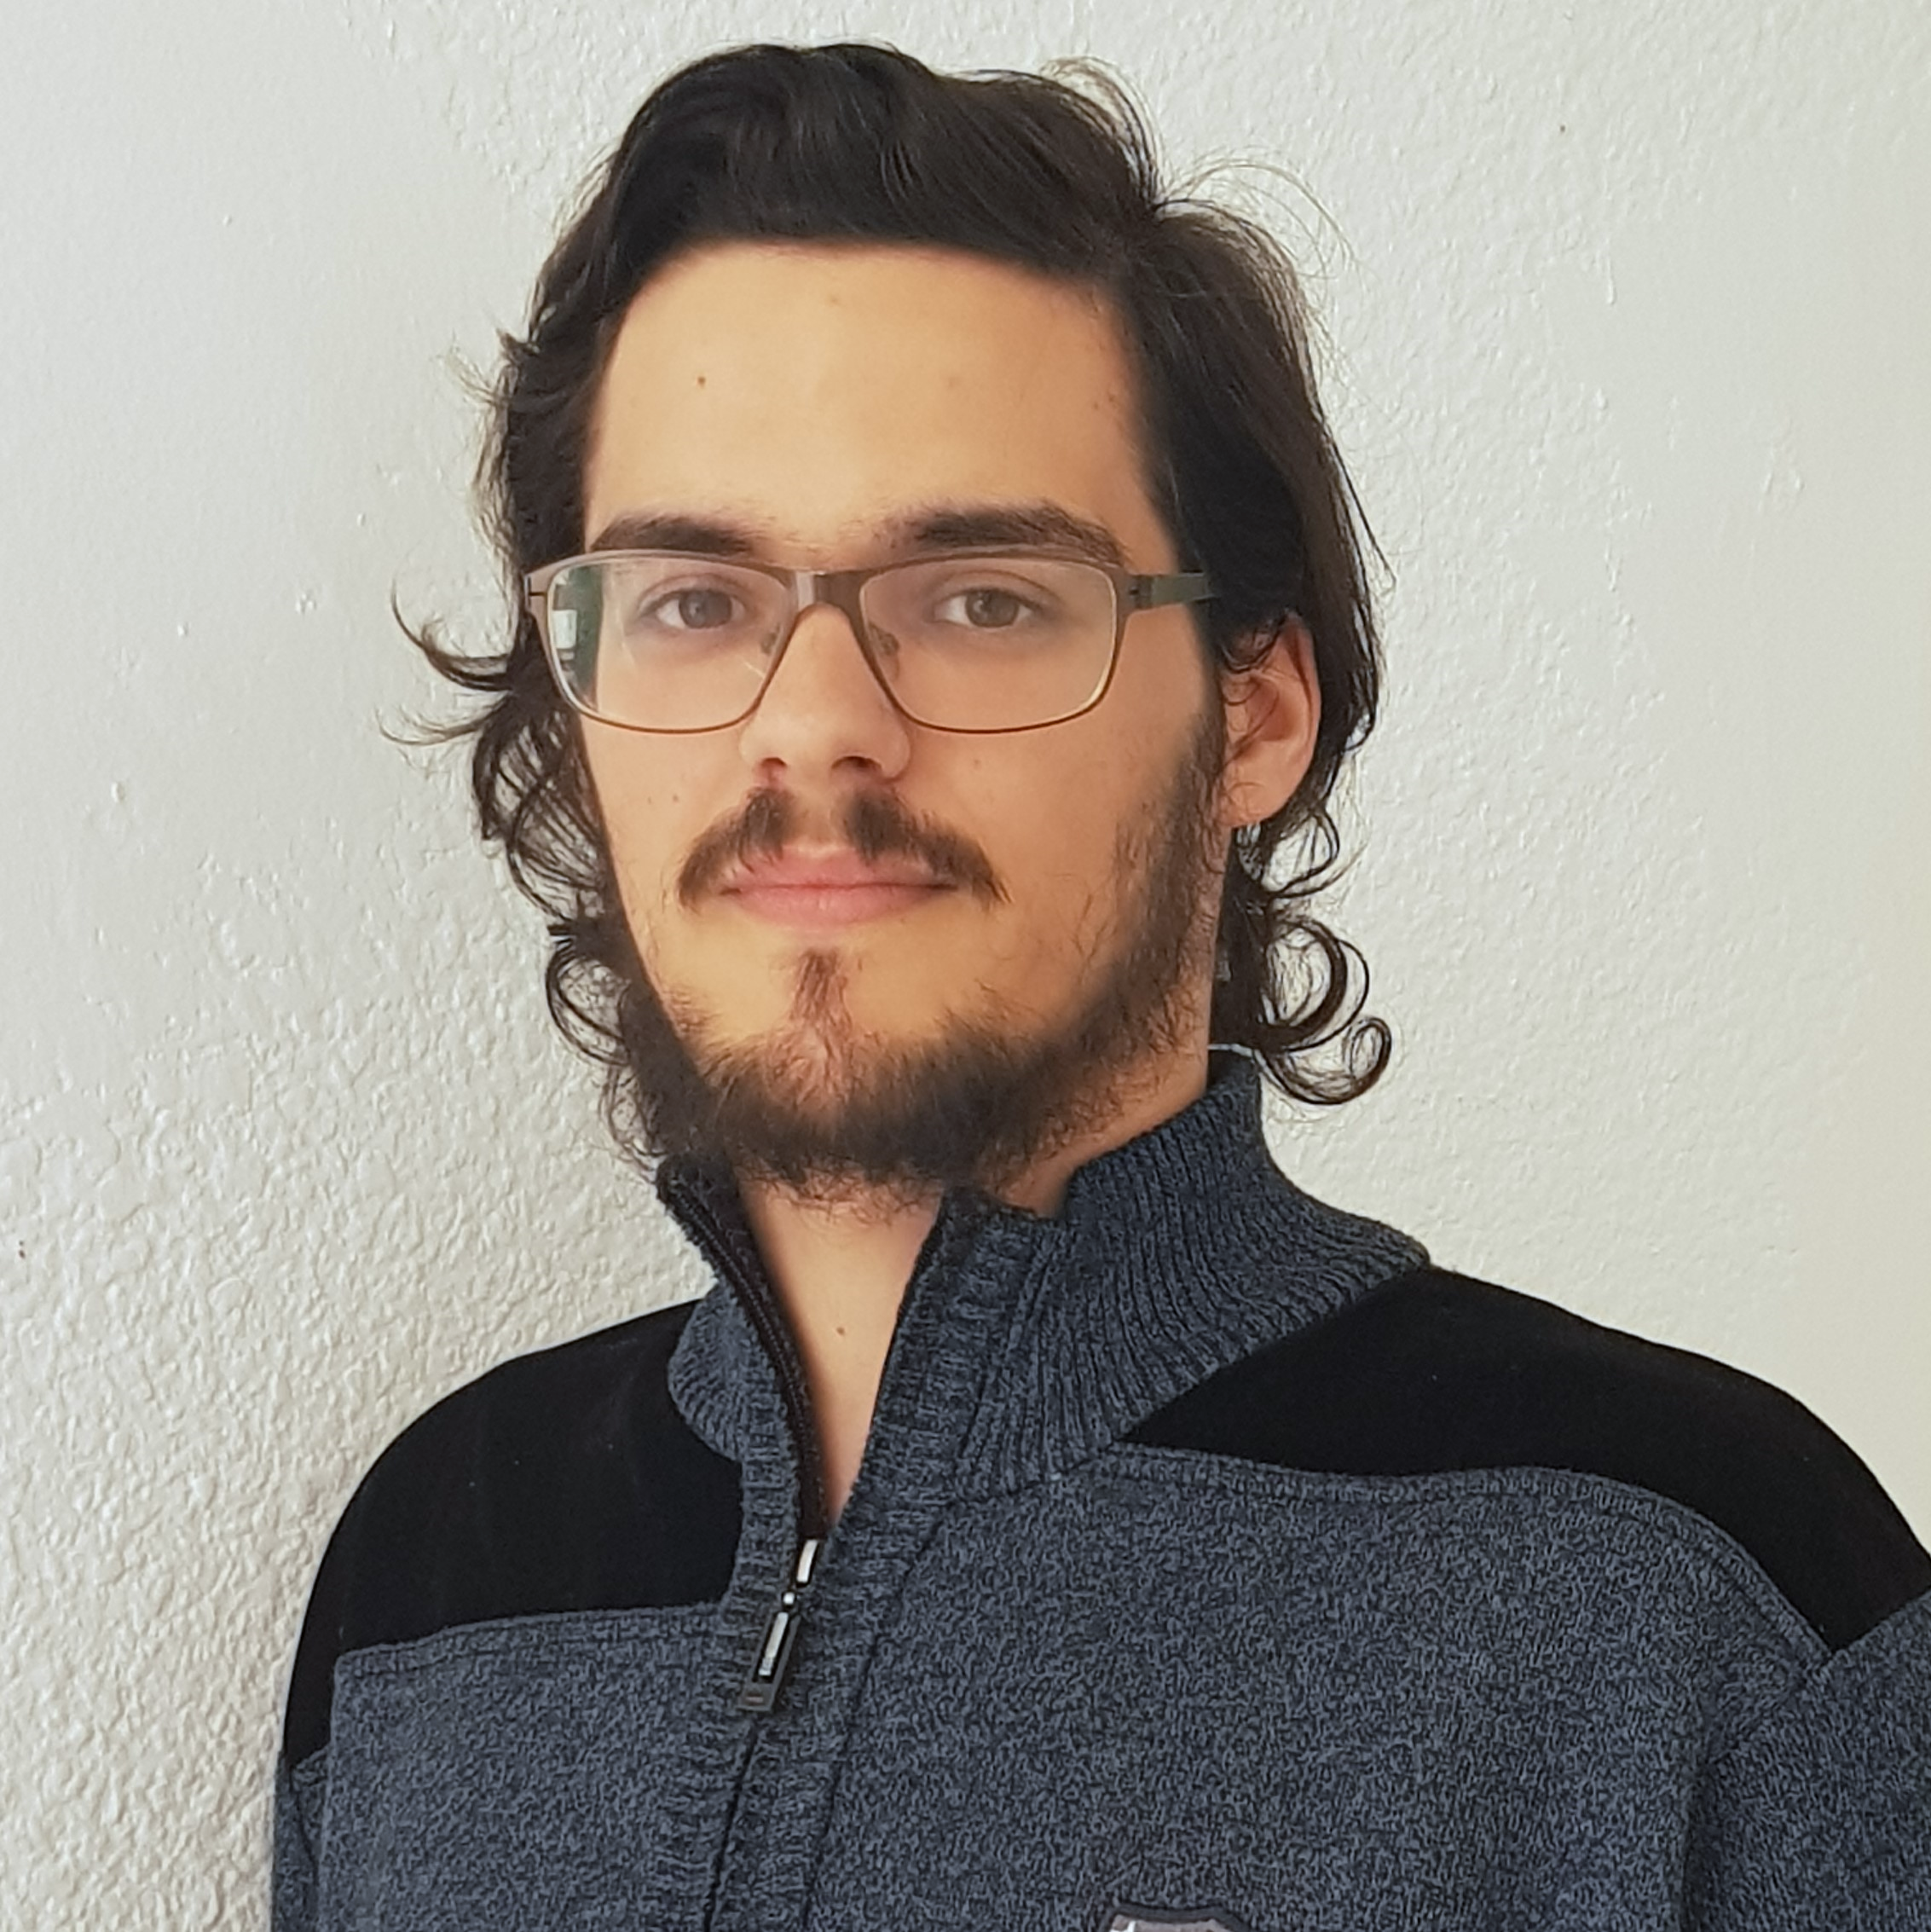



Pablo Rebollo
Project manager, backend developer
Juan Rodríguez
Requirements engineer, backend developer
Adrián Cantón
Business manager, full-stack developer
Rafael Fresno
Backend developer, API integration
Daniel Carpio
Analist,
frontend developer

Slide 18
PLANIFICATION
How do we organize development?

Slide 19
First sprint March 18th – March 29th | Core use cases Piloting plan
Second sprint April 1st – April 12th | Full MVP Feedback taken into account
Third sprint April 22nd – May 3rd | Polished MVP

Slide 20




Performance indicator
$$avg(\frac{Estimated time}{Invested time})$$
0.5
0.8
1.2
1.5
!
~
?

Slide 21
PM performance indicator
$$PMP∗avg\left(MP\right)−TD∗0.1$$
PMP: Project Manager performance
MP: Members performance
TD: Total task delays (days)
0.5
1.5
!
~
?

Slide 22



Factors affecting performance
Optimistic estimation
Wasted time
Difficulties
Pesimistic estimation
Easier tasks
Unknown technology

Slide 23



General solutions
Talk
Reschedule
Balance
Monitor

Slide 24
SPRINT 2 WEEK 1
April 1st – April 7th

Slide 25
 |  | April
Task | Assignees | 1 | 2 | 3 | 4 | 5 | 6 | 7
Initial meeting | All
Local settings | Daniel
User registration | Juan
Remove expired capsules | Pablo
Twitter integration | Rafael
Update modular form | Adrián
Fix pagination issues | Juan
DM email notifications | Pablo

Slide 26
 |  | April
Task | Assignees | 1 | 2 | 3 | 4 | 5 | 6 | 7
UI: Registration | Daniel
Ban users | Juan
UI: User account | Daniel
Automations | Pablo
Basic payment | Adrián
Presentation | Rafael
UI: List and search users | Daniel
Rehearsal | Pablo

Slide 27
Unplanned tasks
Task | Assignees | Invested time (h)
Travis test problems | Daniel | 1.5
Check DM switch when editing capsules | Daniel | 0.25
Fix AJAX search | Juan | 0.5
Add tooltip for notification emails | Daniel | 1
Improve registration form | Juan | 2

Slide 28
Performance
Pablo (PM) | 0.93
Daniel | 1.44
Rafael | 1
Adrián | 0.94
Juan | 1.08

Slide 29


Sprint 1 problem
Bad estimations
Solution:
Divide tasks

Slide 30
Measures
Performance ratio
!
~
?
0.5
0.8
1.2
1.5
Divide tasks
W1 lowest performance: 0.93

Slide 31



Measures
Delay (days)
2
Divide tasks
W1 greatest delay: 2

Slide 32
Measures
Invested hours
6
Divide tasks
W1 task with most hours: 6

Slide 33
Measures
Invested days
6
Divide tasks
W1 task with most days: 5

Slide 34

Sprint 1 problem
Poor tool usage
Solution:
Better tool usage

Slide 35

Measures
Wiki entries
~4
Better
tool usage
Wiki entries after W1: 5

Slide 36


What went wrong?
- What happened?
Django 2.2 broke our tests.
- Solution
Migrate to Django 2.2 and fix
all tests.
Django update

Slide 37
What went wrong?
- Measure
Number of failing tests
Django update
0
Number after W1: 0

Slide 38



What went wrong?
- What happened?
Late deployment led to many
errors.
- Solution
Deploy 2 days before deadline.
Deployment
problems

Slide 39
What went wrong?
- Measure
Days before deadline
Deployment
problems
2
Days in W1: 0

Slide 40
Project duration | 8 weeks (3 development)
Salaries | 20.80 €/hour
Hours per month | 40
Total salaries | 8207 €
Amortization | 60 months
Equipment | 200 €
Hosting | 0 €
Advertising | 0 €
Total | 8407 €

Slide 41
SPRINT 2 WEEK 2
April 8th – April 12th

Slide 42
 |  | April
Task | Assignees | 8 | 9 | 10 | 11 | 12
Feedback meeting | All
Fix functional tests | Adrián
Admin dashboard | Juan
Delete user data | Pablo
Add date picker | Adrián
Fix notification emails | Daniel
Add confirmation button | Daniel
Edit notifications emails | Rafael

Slide 43
 |  | April
Task | Assignees | 8 | 9 | 10 | 11 | 12
“About us” page | Daniel
Add return button | Daniel
Fix frontend errors | Daniel
Deploy app | Adrián
Test app | Daniel, Juan
Presentation | Rafael
Pilot users form | Pablo
User manual | Pablo

Slide 44
 |  | April
Task | Assignees | 8 | 9 | 10 | 11 | 12 | 20 | 21
Sprint 2 retrospective doc | Pablo
Rehearsal | Pablo

Slide 45
Unplanned tasks
Task | Assignees | Invested time (h)
Update populate | Pablo | 0.5
Fix capsule edition URL | Adrián | 0.25

Slide 46
Performance
Pablo (PM) | 1.23
Daniel | 1.9
Rafael | 0.96
Adrián | 1.33
Juan | 1

Slide 47
Measures
Performance ratio
!
~
?
0.5
0.8
1.2
1.5
Divide tasks
W2 lowest performance: 0.96

Slide 48
Measures
Delay (days)
2
Divide tasks
W2 greatest delay: 0

Slide 49
Measures
Invested hours
6
Divide tasks
W2 task with most hours: 5.5

Slide 50
Measures
Invested days
6
Divide tasks
W2 task with most days: 5

Slide 51
Measures
Wiki entries
~4
Better
tool usage
Wiki entries after W2: 5

Slide 52
What went wrong?
- Measure
Days before deadline
Deployment
problems
2
Days in W2: 2

Slide 53


What went wrong?
No problems during week 2!

Slide 54


Why?
- No complex tasks
- No technical problems
- Main frontend already developed

Slide 55
Delayed tasks
- Facebook integration
- Performance tests
- SonarCloud set up

Slide 56
Lessons learnt
Software updates
Monitor and test

Slide 57
Lessons learnt
Late deployment
Earlier deployments

Slide 58


Lessons learnt
No piloting plan feedback
Earlier feedback discussion

Slide 59


Lessons learnt
Changes affecting data
Review populate script

Slide 60

Lessons learnt
Higher performance
Better estimations

Slide 61


Lessons learnt
Bug tracking
GitHub issues ratios

Slide 62
GitHub issues ratios
- Bugs over new features
Current ratio: 8/128=0.06
- Time invested on bugs over time invested on new features

Slide 63
Project duration | 9 weeks (4 development)
Salaries | 20.80 €/hour
Hours per month | 40
Total salaries | 9217 €
Amortization | 60 months
Equipment | 238 €
Hosting | 0 €
Advertising | 0 €
Total | 9455 €

Slide 64
DEMO
How does the system look like?

Slide 65
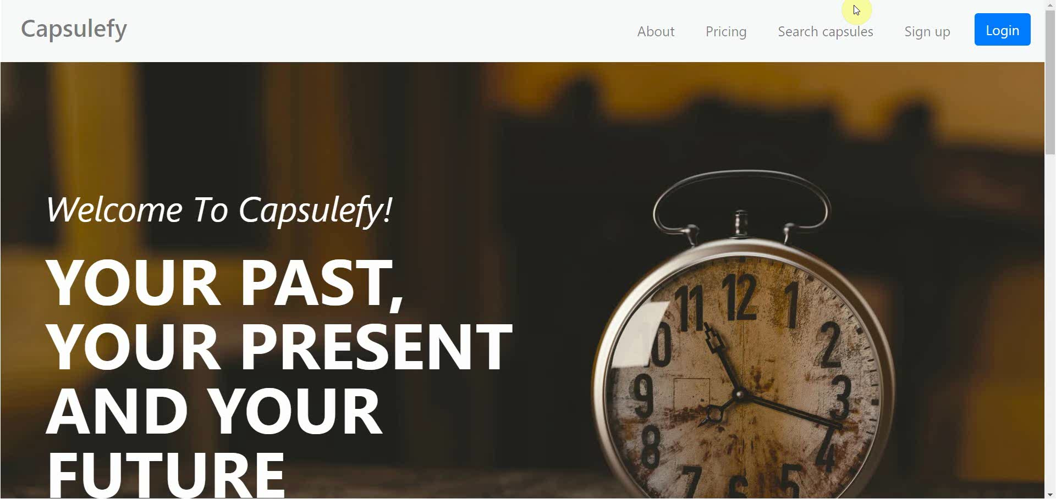
No logged user – List, search and display capsules

Slide 66

No logged user – Sign up

Slide 67
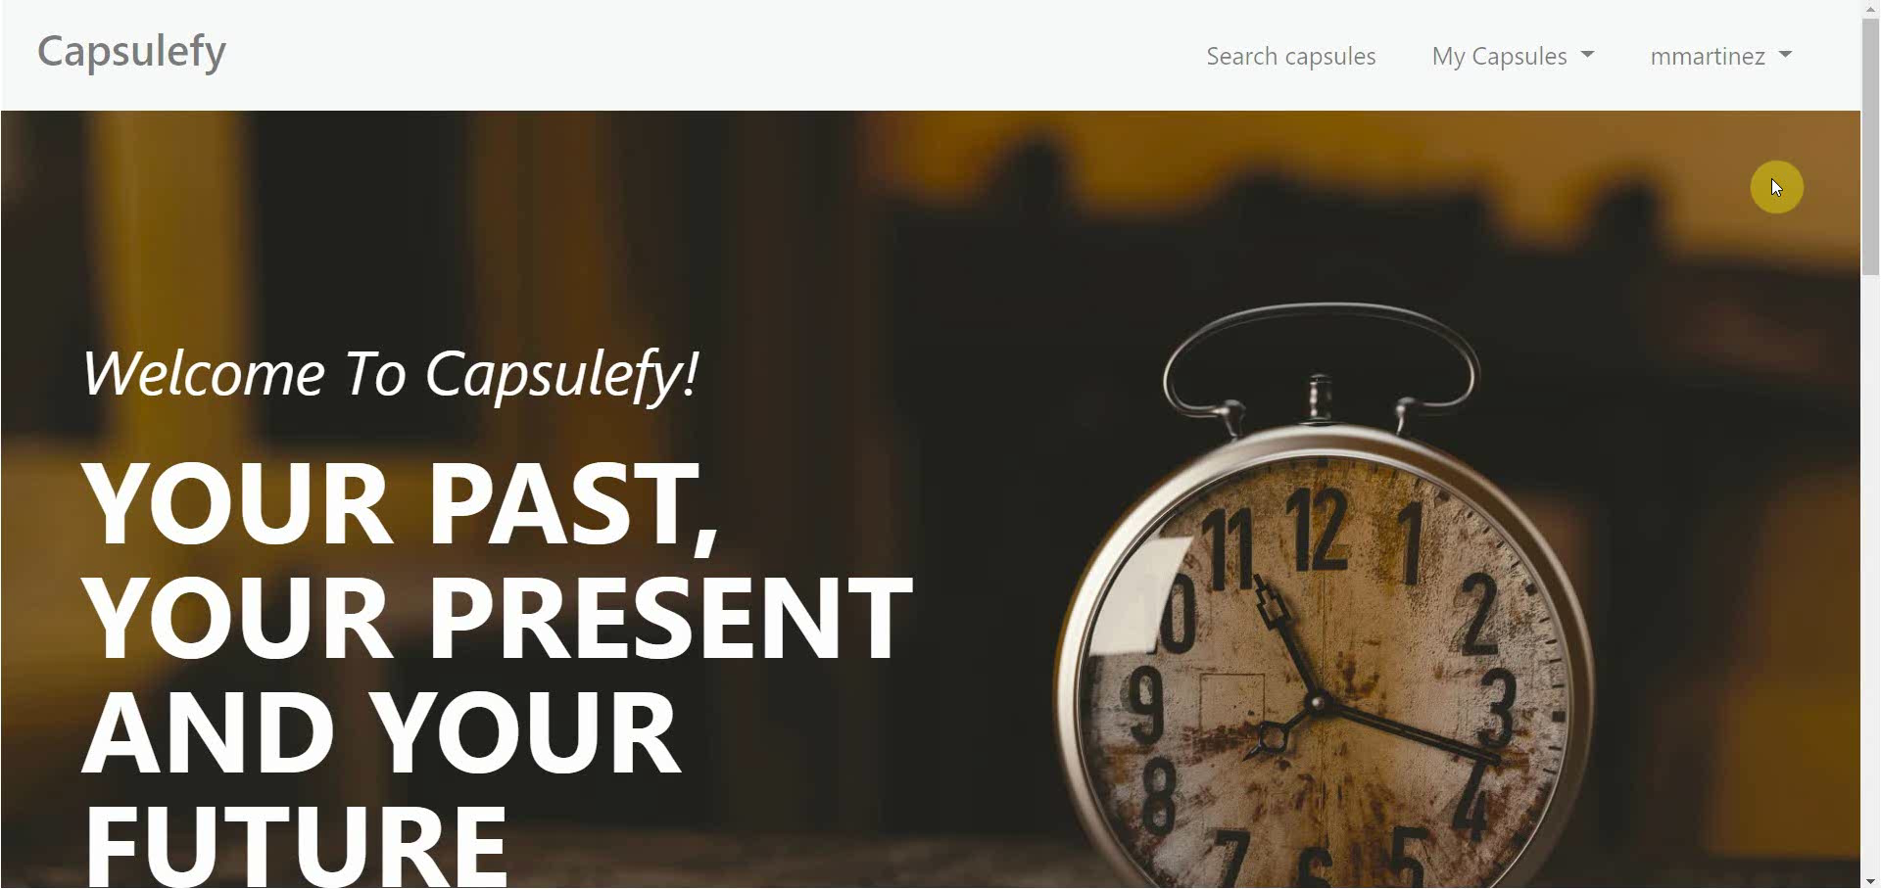
Logged-in user – My account

Slide 68
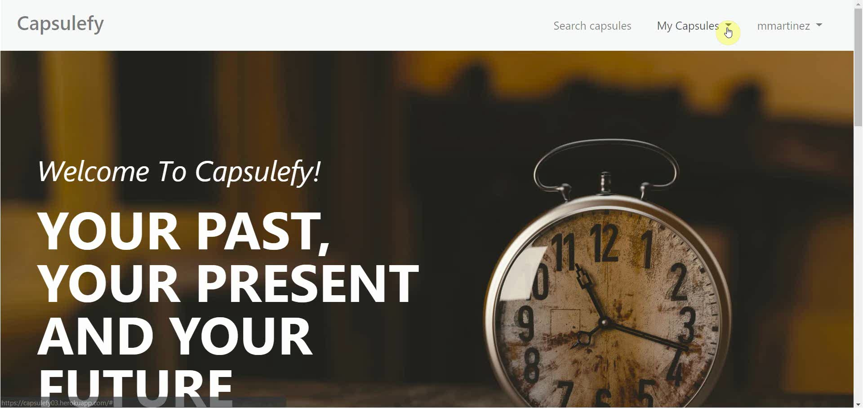
Logged-in user – Modular capsules

Slide 69

Logged-in user – Edit capsules

Slide 70
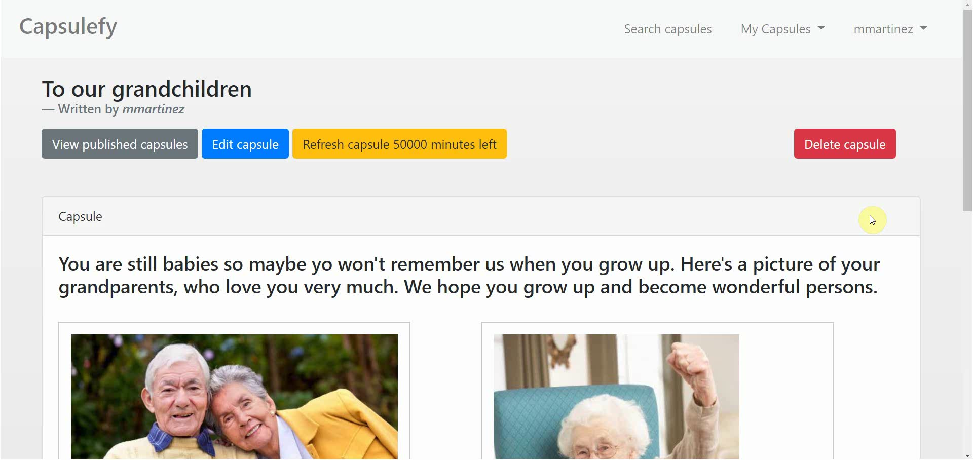
Logged-in user – Delete modules

Slide 71
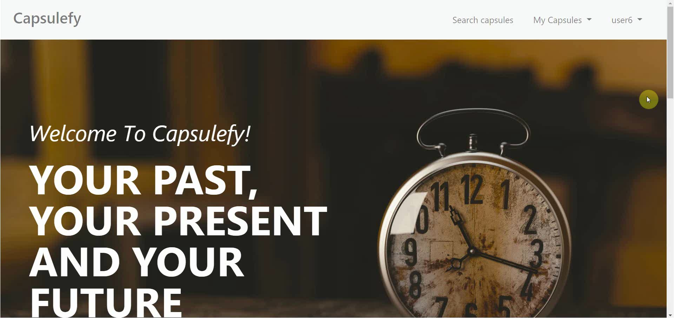
Logged-in user – Refresh timer

Slide 72
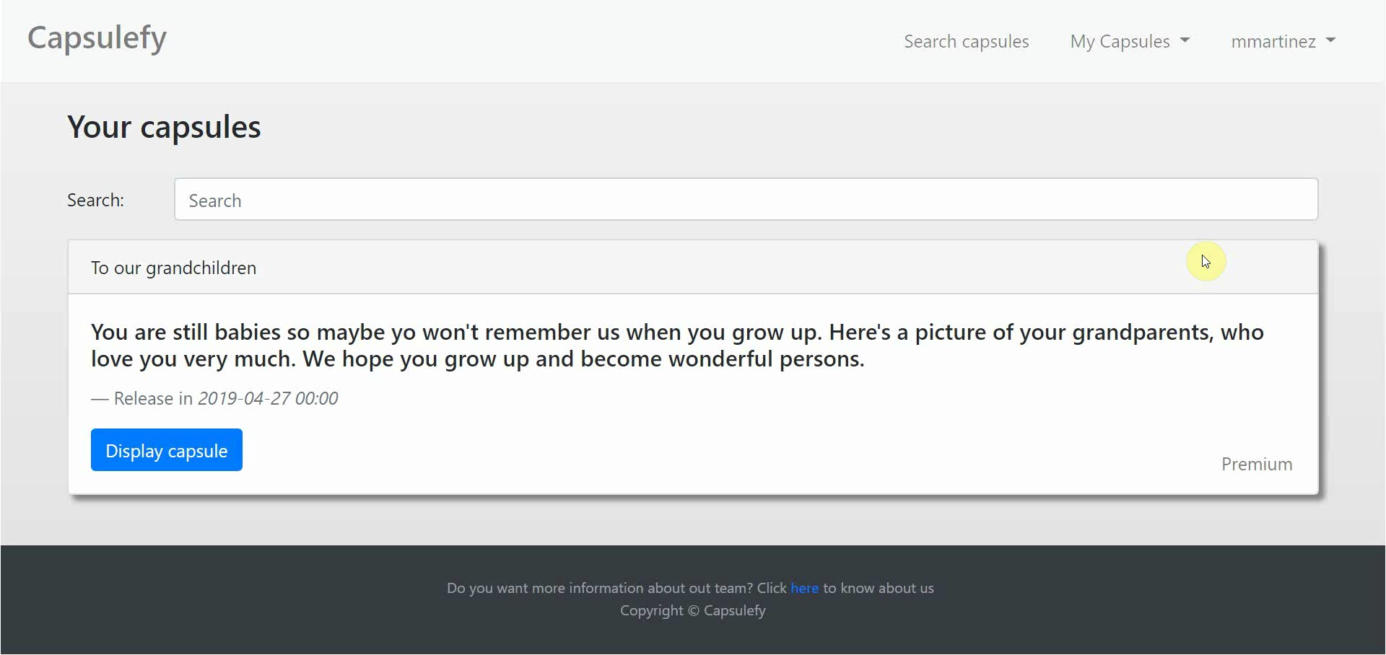
Logged-in user user – Delete capsules

Slide 73
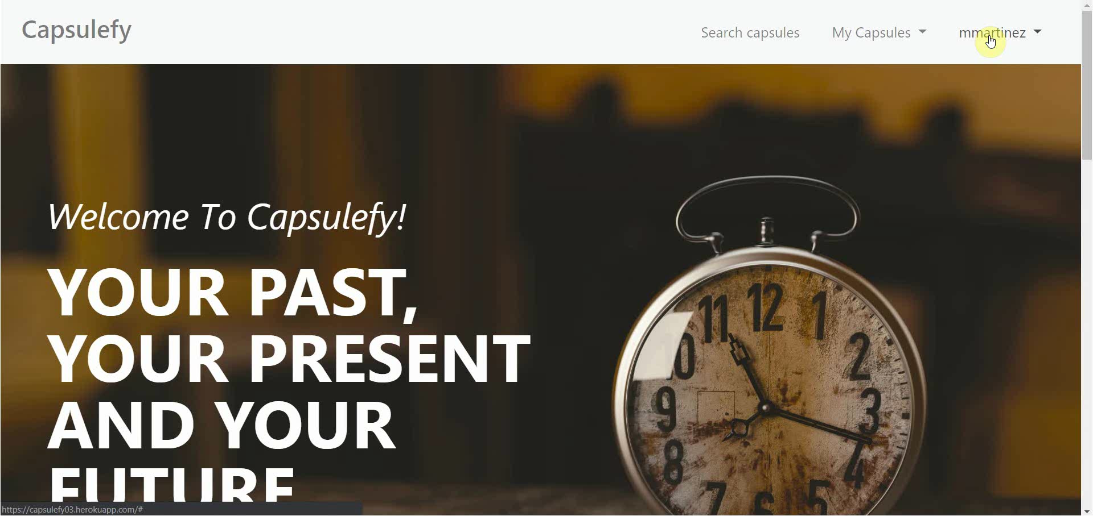
Logged-in user – Delete user data

Slide 74

Admin – List and ban users

Slide 75
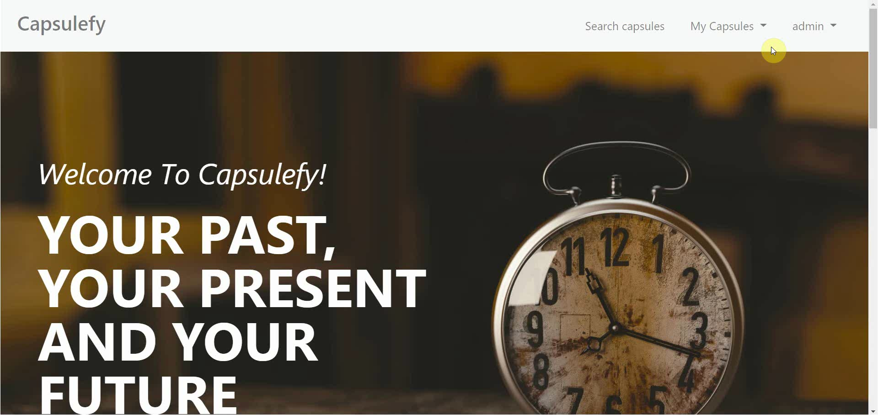
Admin – Dashboard

Slide 76
SPRINT 2 RESULTS
What was produced?

Slide 77

Documentation
Sprint 2 documentation
Updated user manual and pilot users form
Development
Frozen app: https://capsulefy03.herokuapp.com
GitHub release: https://github.com/pabreblob/capsulefy/releases

Slide 78
SPRINT 3 WEEK 1
April 22nd – April 28th

Slide 79

Note
The following planification will change based on feedback!

Slide 80
 |  | April
Task | Assignees | 22 | 23 | 24 | 25 | 26 | 27 | 28
Initial meeting | All
Clean up code | Juan
Improve checkboxes | Daniel
Improve resposive | Daniel
Facebook integration | Rafael
Performance tests | Pablo
SonarCloud set up | Adrián
Fix image proportions | Daniel

Slide 81
 |  | April
Task | Assignees | 22 | 23 | 24 | 25 | 26 | 27 | 28
Improve dashboard | Juan
Review populate | Pablo
Deployment | Adrián
Presentation | Rafael
Rehearsal | Pablo

Slide 82
SPRINT 3 WEEK 2
April 29th – May 3rd

Slide 83
 |  | April |  | May
Task | Assignees | 29 | 30 | 1 | 2 | 3
Feedback meeting | All
Improve Firebase | Adrián
Improve automation | Pablo
Add landing content | Daniel
Date picker in sign up | Daniel
Fix social networks | Rafael
Fix backend problems | Juan
Review populate | Juan

Slide 84
 |  | April |  | May
Task | Assignees | 29 | 30 | 1 | 2 | 3
Deploy app | Adrián
Test app | Daniel, Juan
Presentation | Rafael
Pilot users form | Pablo
User manual | Pablo
Sprint 3 retrospective doc | Pablo
Rehearsal | Pablo

Slide 85
PILOTING PLAN
How will users test Capsulefy?

Slide 86


Create manual
Create test suite
Test the system
Gather feedback
Fill form

Slide 87
Committed users
Name | Age
Francisco R. | 55
Javier A. | 19
Valentin A. | 19
Antonio G. | 26
José Manuel J. | 21
Name | Age
Sandra C. | 28
José Manuel C. | 21
Rafael C. | 55
Antonio C. | 54
Auxiliadora L. | 50

Slide 88
Sprint 2
Users receive and fill form
March 30 – April 6
Development
April 8 – April 12
Receive users feedback
April 6
Planification
April 8

Slide 89
FIRST FEEDBACK RESULTS
What did users say?

Slide 90

“There is no confirmation button when deleting a capsule or a module”

Slide 91


Solution
Status
Add a confirmation button
Done
During sprint 2, week 2

Slide 92
“Manually entering a date is hard because of the required format”

Slide 93
Solution
Status
Add a visual date picker
Done
During sprint 2, week 2

Slide 94
“There is no return button after displaying a capsule”

Slide 95

Solution
Status
Started
During sprint 2, week 2
To be planned
After next feedback results
Add a return button

Slide 96
“I do not fully understand some concepts, such as the deadman switch”

Slide 97

Solution
Status
Add a help section with videos
To be planned
After next feedback results

Slide 98
“404 error pages do not have a user-friendly look”

Slide 99
Solution
Status
Create a better view for 404 error pages
To be planned
After next feedback results
404

Slide 100
“It is not clear that multiple emails must be separated by commas”

Slide 101
Solution
Status
Add a placeholder to multiple email inputs
To be planned
After next feedback results

Slide 102
Sprint 3
Easter Week
Users receive and fill form
April 12 – April 22
Development
April 22 – May 3
Receive users feedback
April 22
Planification
April 22

Slide 103
After development
Users receive and fill form
May 4 – May 12
Receive users feedback
May 12
Planification
May 13

Slide 104
Documentation
Manual (PDF)
Test suite
Form
https://forms.gle/NmN7pxV28oh9hCcV6

Slide 105
Thanks!
Upstream: https://capsulefy.herokuapp.com
Sprint 2: https://capsulefy03.herokuapp.com
Landing page: https://capsulefy01.herokuapp.com
capsulefy.communications@gmail.com
Pilot users form: https://forms.gle/https://forms.gle/NmN7pxV28oh9hCcV6
GitHub releases: https://github.com/pabreblob/capsulefy/releases

Slide 106


Deadman switch
ON

Slide 107

Teamwork
Skills
Profitable work
Positive feedback

Slide 108


Realistic | 29968 – 31330 €
Optimistic | 28061 €
Pesimistic | 34054 €
Project duration: 4 months

Slide 109


Risk | Mitigation
Broken computer | Risk prevention funds
Changing terms of use | Monitor
Servers down | Monitor
Incompatible timetables | Reschedule

Slide 110
Year 1: 2000 sales
Balance: -10168 €
Year 2: 4000 sales
Balance: 16273 €
29968 €
39600 €
19800 €
13159 €
Costs
Earnings
Costs
Earnings

Slide 111
Year 3: 8000 sales
Balance: 81450 €
79200 €
14023 €
Costs
Earnings

Slide 112

Monthly advertising costs
220 €
140 €
150 €

Slide 113
SPRINT 1 WEEK 1
March 18th – March 22nd

Slide 114
Task | Assignees | Est. (h) | Inv. (h) | Status
Data model | Adrián, Daniel | 4 | 1.5 | Finished
Set up environment | All | 2.5 | 2.5 | Finished
Angular research | Daniel | 1 | 2 | Aborted
Data model implementation | Juan | 2.5 | 2 | Finished
Populate database | Pablo | 2 | 3.2 | Finished
Basic capsule CRUD | Rafael | 2.5 | 9 | To be tested
Display capsules | Adrián | 2 | 5 | To be tested
TIME

Slide 115
Task | Assignees | Est. (h) | Inv. (h) | Status
Listing capsules | Juan | 1.5 | 1 | To be tested
User login | Juan | 1 | 1 | To be tested
Advertisement budget | Pablo | 1.5 | 1.5 | Finished
User interface | Daniel | 1 | 10 | Finished
Documentation | Daniel, Adrián, Juan | 1.5 | 1.5 | Finished
Presentation | Pablo, Rafael | 3 | 4 | Finished
Review meeting | All | 2.5 | 2.5 | Finished
TIME

Slide 116
Performance
Adrián | 1.34
Daniel | 1.05
Rafael | 0.67
Pablo | 0.84
Juan | 1.06

Slide 117

What went wrong?
No Angular knowledge
Bad estimations
Lack of time

Slide 118
SPRINT 1 WEEK 2
March 25th – March 29th

Slide 119
Task | Assignees | Est. (h) | Inv. (h) | Status
Feedback meeting | All | 5 | 5 | Finished
Travis CI set up | Adrián, Rafael | 2 | 3 | Finished
Modular capsules | Adrián | 5 | 4.5 | Finished
Private capsules | Juan | 2 | 1.5 | Finished
Email automation | Juan | 2 | 1.5 | Finished
Search capsules | Daniel | 1.5 | 1 | Finished
List own capsules | Juan | 1 | 1 | Finished
Pagination | Juan | 1 | 3 | Finished
TIME

Slide 120
Task | Assignees | Est. (h) | Inv. (h) | Status
Deadman switch | Pablo | 4 | 5 | Finished
Social network integration | Rafael | 4 | 1 | Postponed
User interface | Daniel | 4 | 7 | Finished
Piloting plan | Adrián | 2.5 | 1 | Finished
Sprint meeting | All | 5 | 5 | Finished
Documentation | Adrián, Daniel, Juan | 1.5 | 1.5 | Finished
Presentation | Rafael | 3 | 5.5 | Finished
Deliverable | Pablo | 3 | 4 | Finished
TIME

Slide 121
Performance
Adrián | 1.32
Daniel | 1.03
Rafael | 0.60
Pablo | 0.77
Juan | 0.87

Slide 122
What went wrong?
Performance further reduced
Implementation differences
Lack of time

Slide 123
What actions were taken?
Meet
Reschedule
Reestimate

Slide 124
Total performance
Adrián | 1.31
Daniel | 1.02
Rafael | 0.63
Pablo | 0.80
Juan | 0.96

Slide 125

Taken actions
Detailed planning
Time for documentation
Better tool usage
Divide tasks

Slide 126
SPRINT 1 RESULTS
What was produced?

Slide 127
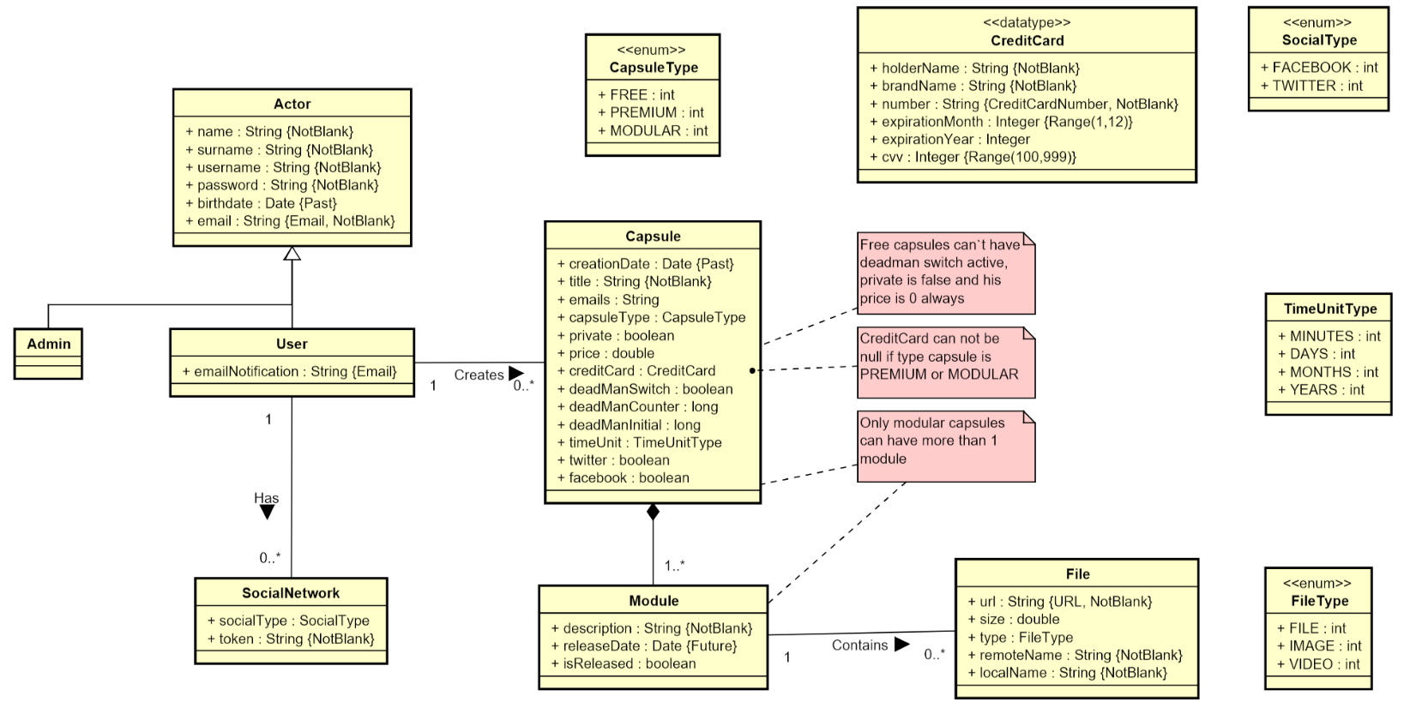

Slide 128
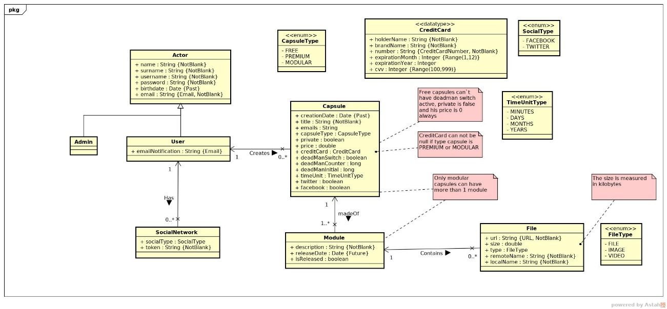

Slide 129
Documentation
Sprint 1 documentation
Piloting plan
Development
Frozen app: https://capsulefy02.herokuapp.com
GitHub release: https://github.com/pabreblob/capsulefy/releases

Slide 130
Project duration | 7 weeks (2 development)
Salaries | 20.80 €/hour
Hours per month | 40
Total salaries | 6989 €
Amortization | 60 months
Equipment | 134.16 €
Hosting | 0 €
Advertising | 0 €
Total | 7123.16 €

Slide 131
Quality (p) | MB/minute
144 | 1.3
240 | 3.3
360 | 5
480 | 8.3
720 | 25
1080 | 50

Slide 132
SPRINT 2 WEEK 1
April 1st – April 7th

Slide 133
Task | Assign. | Start | End | Est. (h) | Inv. (h)
Initial meeting | All | Apr 1 | Apr 1 | 1.5 | 1.5
Local settings | Daniel | Apr 2 | Apr 2 | 1 | 0.5
User registration | Juan | Apr 2 | Apr 2 | 2 | 2
Remove expired capsules | Pablo | Apr 2 | Apr 2 | 1.5 | 1.5
Twitter integration | Rafael | Apr 2 | Apr 4 | 4 | 4
Update modular form | Adrián | Apr 2 | Apr 3 | 5 | 6
Fix pagination issues | Juan | Apr 3 | Apr 3 | 1.5 | 1.5
DM switch notifications | Pablo | Apr 3 | Apr 4 | 1.5 | 2
UI: Registration | Daniel | Apr 3 | Apr 4 | 0.5 | 0.25
TIME

Slide 134
Task | Assign. | Start | End | Est. (h) | Inv. (h)
Ban users | Juan | Apr 4 | Apr 6 | 2 | 1.5
UI: User account | Daniel | Apr 4 | Apr 6 | 1.5 | 1.25
Automation improvements | Pablo | Apr 4 | Apr 7 | 4 | 4.5
Basic payment | Adrián | Apr 5 | Apr 7 | 4 | 4
Presentation | Rafael | Apr 5 | Apr 7 | 3 | 3
UI: List and search users | Daniel | Apr 6 | Apr 7 | 2 | 2
Rehearsal | Pablo | Apr 7 | Apr 7 | 1.5 | 1
TIME

Slide 135
SPRINT 2 WEEK 2
April 8th – April 12th

Slide 136
Task | Assign. | Start | End | Est. (h) | Inv. (h)
Feedback meeting | All | Apr 8 | Apr 8 | 1.5 | 1.5
Fix functional tests | Adrián | Apr 8 | Apr 10 | 0.75 | 0.5
Admin dashboard | Juan | Apr 8 | Apr 10 | 3 | 3
Delete user data | Pablo | Apr 8 | Apr 10 | 1.5 | 2
Add date picker | Adrián | Apr 8 | Apr 10 | 1 | 1
Fix notification emails | Daniel | Apr 8 | Apr 10 | 0.5 | 0.2
Add confirm button | Daniel | Apr 8 | Apr 10 | 1 | 0.4
Edit notification email | Rafael | Apr 8 | Apr 10 | 1 | 1
TIME

Slide 137
Task | Assign. | Start | End | Est. (h) | Inv. (h)
“About us” page | Daniel | Apr 8 | Apr 10 | 0.25 | 0.25
Add return button | Daniel | Apr 8 | Apr 10 | 1 | 0.25
Fix frontend errors | Daniel | Apr 8 | Apr 10 | 1.5 | 1.5
Deploy app | Adrián | Apr 10 | Apr 10 | 2 | 1.5
Test app | Daniel, Juan | Apr 10 | Apr 12 | 2 | 2
Presentation | Rafael | Apr 10 | Apr 12 | 5 | 5.5
Pilot user form | Pablo | Apr 8 | Apr 12 | 1.5 | 2
User manual | Pablo | Apr 8 | Apr 12 | 1 | 0.75
TIME

Slide 138
Task | Assign. | Start | End | Est. (h) | Inv. (h)
Sprint 2 retrospective doc | Pablo | Apr 8 | Apr 12 | 4 | 4
Rehearsal | Pablo | Apr 20 | Apr 21 | 1.5 | -
TIME

Slide 139
SPRINT 3 WEEK 1
April 22th – April 28th

Slide 140
Task | Assign. | Start | End | Est. (h) | Inv. (h)
Initial meeting | All | Apr 22 | Apr 22 | 1.5 | -
Clean up code | Juan | Apr 22 | Apr 23 | 3 | -
Improve checkboxes | Daniel | Apr 22 | Apr 22 | 1 | -
Improve responsive | Daniel | Apr 23 | Apr 26 | 5 | -
Facebook integration | Rafael | Apr 22 | Apr 25 | 1.5 | -
Performance tests | Pablo | Apr 22 | Apr 25 | 4 | -
SonarCloud set up | Adrián | Apr 22 | Apr 24 | 5 | -
Fix image proportions | Daniel | Apr 24 | Apr 25 | 0.5 | -
TIME

Slide 141
Task | Assign. | Start | End | Est. (h) | Inv. (h)
Improve dashboard | Juan | Apr 24 | Apr 25 | 2 | -
Revise populate | Pablo | Apr 25 | Apr 25 | 1 | -
Deployment | Adrián | Apr 26 | Apr 26 | 1.5 | -
Presentation | Rafael | Apr 26 | Apr 28 | 3 | -
Rehearsal | Pablo | Apr 28 | Apr 28 | 1 | -
TIME

Slide 142
SPRINT 3 WEEK 2
April 29th – May 3rd

Slide 143
Task | Assign. | Start | End | Est. (h) | Inv. (h)
Feedback meeting | All | Apr 29 | Apr 29 | 1.5 | -
Improve Firebase | Adrián | Apr 29 | Apr 30 | 2 | -
Improve automation | Pablo | Apr 29 | Apr 30 | 2 | -
Add landing content | Daniel | Apr 29 | Apr 30 | 3 | -
Date picker in sign up | Daniel | Apr 29 | Apr 30 | 0.5 | -
Fix social networks | Rafael | Apr 29 | Apr 30 | 2 | -
Fix backend problems | Juan | Apr 29 | Apr 30 | 2 | -
Revise populate | Juan | Apr 30 | Apr 30 | 1 | -
TIME

Slide 144
Task | Assign. | Start | End | Est. (h) | Inv. (h)
Deploy app | Adrián | May 1 | May 1 | 2 | -
Test app | Daniel, Juan | May 1 | May 3 | 2 | -
Presentation | Rafael | May 1 | May 3 | 5 | -
Pilot users form | Pablo | May 1 | May 3 | 1.5 | -
User manual | Pablo | May 1 | May 3 | 1 | -
Sprint 3 retrospective doc | Pablo | May 1 | May 3 | 4 | -
Rehearsal | Pablo | May 3 | May 3 | 1.5 | -
TIME

